Slide 1
SILENT SCREAMER
Group 2
Dhrumil Parikh (110072217)
Prince Patel (110072773)
Hetansh Shah (110074680)
Yash Bhalala (110085755)
Ahmed Abdullah (110068897)
Ahmed Mustafa (110078623)
Vrushit Bharucha (110073524)
Dola Sai Thota (110088374)

Slide 2
Introduction
Customer Requirements
Key Features
Tools and Technology
Methodology
Quality Management
Risk Management
Design
Demonstration
Future Plan
Conclusion
TABLE OF CONTENTS

Slide 3
INTRODUCTION
It’s a horror survival game played from a first-person perspective ​
The player works solo to complete the game
To win, the player has to kill all the ghosts.
Two types of ghost: 1) Primary and 2) Secondary
Weapons are available to kill the ghosts

Slide 4
Game​
Horror Theme​
Interaction with the environment​
Entertainment​
Available to maximum users
Engaging
CUSTOMER REQUIREMENTS

Slide 5
KEY FEATURES
Environments​
Inventory​
Weapon handling capabilities​
User movements​
Ghost interactions​
Primary and Secondary Ghosts killing and animation​
Voice command-based interactions​
Points System​

Slide 6




T
E
C
H
N
O
L
O
G
Y

Slide 7




TOOLS TO CONTROL METHODOLOGY​

Slide 8
Scrum
Sprint Duration – 2 weeks​
Product backlogs
Meeting with the Customer​
Meeting with Project Director​
Daily Meetings
METHODOLOGY

Slide 9
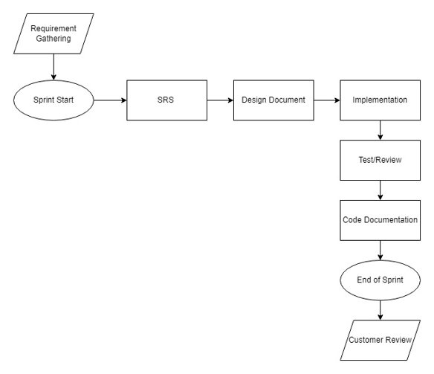
FLOW OF SPRINT

Slide 10
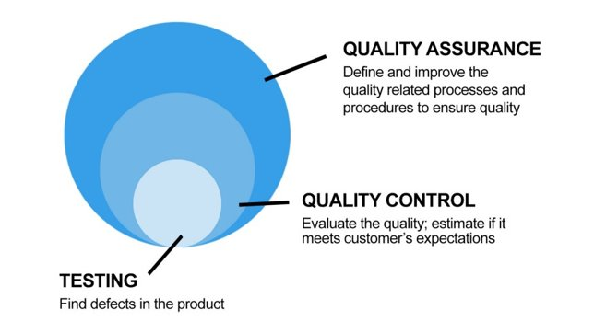
QUALITY MANAGEMENT
Confirming that the final product is consistent with the requirements and specifications before release​
Quality of Code​
File Structure​
Code Documentation​
Creating records for the issues discovered and assigning them to the correct developer for getting the issue resolved​

Slide 11
RISK MANAGEMENT
Inaccurate Estimations​
Inaccurate estimations of the project lead to an increase in project length and eventually it also increases the project expanses​
Scope Variations​
It significantly impacts the ability of the developers to stick to the original timeline of a project​
Poor Productivity​
Use of incorrect methodology​
Lack of communication between team members and leader​
Poor project management​

Slide 12
RISK MANAGEMENT
Poor Quality of code and Technical Errors
Constant changes in software requirements
Code that exhibits buggy behavior
Lack of professionalism & knowledge
Poor Budget Estimation
Unexpected Project Expansion
No fund reserved for the project
Calculation errors
Inadequate Human Resources
Development team member might leave a project unexpectedly

Slide 13
DESIGN
Model
Controller
View
PREFAB OBJECTS
SCRIPTS
SCENES / CAMERA
Architecture (MVC)

Slide 14
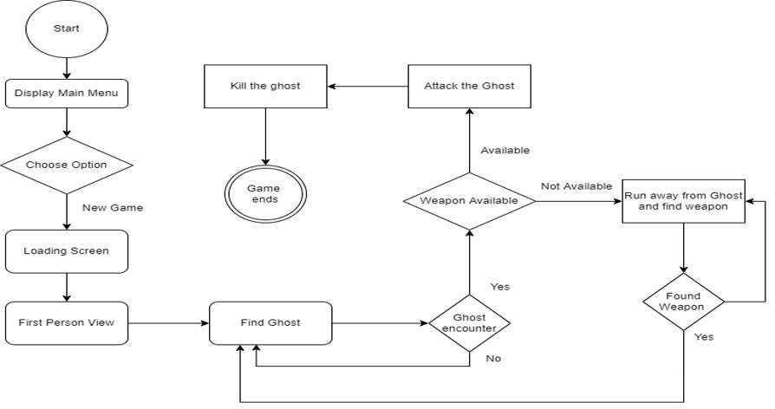
FLOW OF THE GAME

Slide 15
Ghost standing idle
Look for player using Ray Cast
Player found
Run to player
GHOST ATTACK LOGIC
Player in proximity
Attack player
Player attacked
Reduce player’s health

Slide 16
Hit ghost with Axe
Ghost dies after 5 hits
GHOST DAMAGE LOGIC
Hit ghost with Knife
Ghost dies after 10 hits
Hit ghost with Sword
Ghost dies after 1 hit

Slide 17
SPECIAL WEAPON LOGIC
Our special weapon is the sword
It can be equipped once ghosts in the mansion are dead​
Can only be used using voice command – “Shoot”
Equip Sword
Hit Ghost using voice command
Ghost Dies Immediately

Slide 18
D E M O

Slide 19

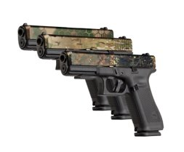

FUTURE PLAN

Slide 20
We were able to create a 3D desktop game by implementing SCRUM methodology using the Unity 3D tool and managed the development of the product by using Jira Software. We have analyzed a few more features that can be added to the game to make it attractive.​
CONCLUSION

Slide 21
REFERENCES
https://docs.unity3d.com/Manual/index.html
https://docs.unity3d.com/ScriptReference/
https://docs.microsoft.com/en-us/archive/msdn-magazine/2014/august/unity-developing-your-first-game-with-unity-and-csharp
https://www.atlassian.com/agile
https://www.atlassian.com/agile/scrum
https://www.atlassian.com/agile/project-management

Slide 22
THANK YOU

